Slide 1
DSC 640 – Week 11 & 12 Michael Ersevim
Notes:
This week, two of the charts for Python (Scatter plot and Bullet Graph) were embedded in the code section, and not separate like the Waterfall and Box plot.
Also, the ‘made up’ data I used to create all the Waterfall graphs is shown within the Python code section.

Slide 2
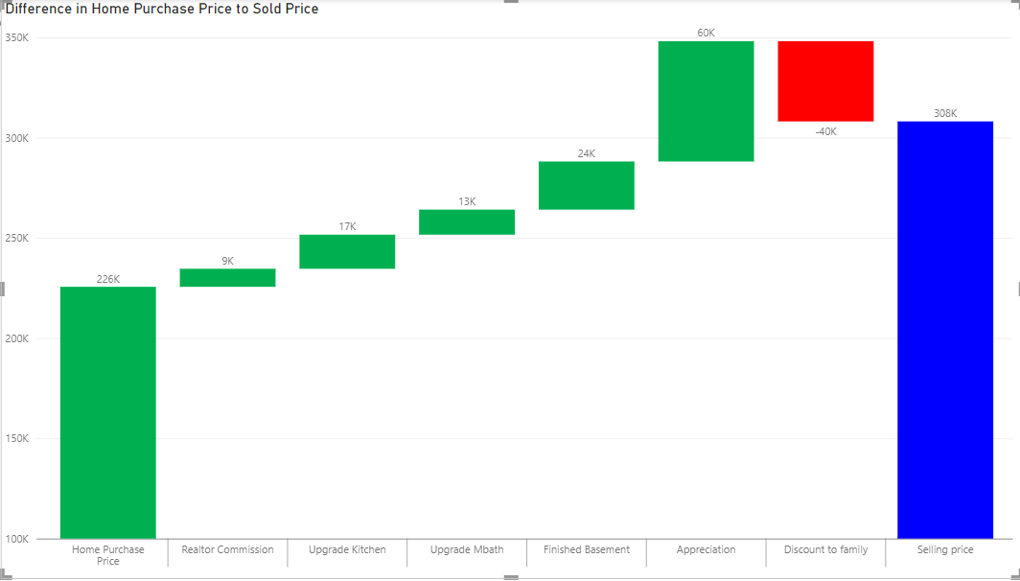
Power BI: Waterfall chart
A Waterfall chart of causes of home price differential bought vs sold

Slide 3
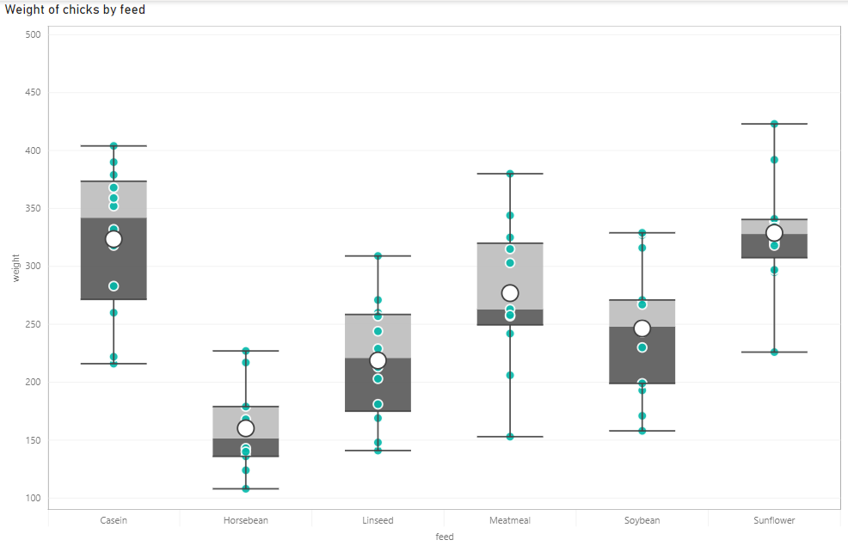
Power BI: Box Plot
Box plot of weight (in grams) of different groups of chicks being fed a certain feed type

Slide 4
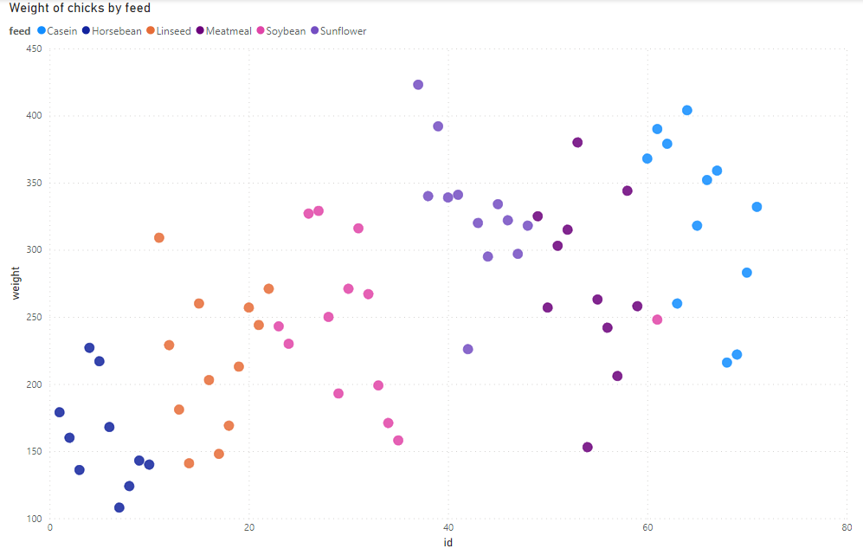
Power BI: Scatter Plot
A scatterplot of chick weights by feed type (denoted by colors)

Slide 5
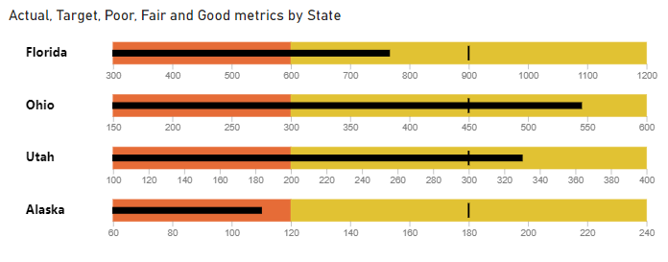
Power BI: Bullet Graph
A Bullet Graph of target metrics by state

Slide 6
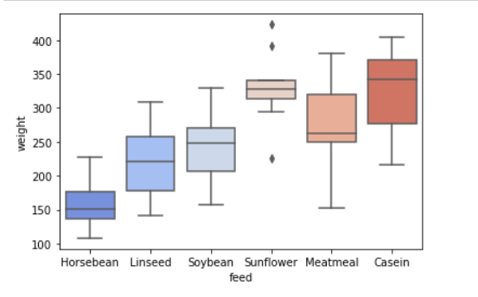
Python: Box Plot

Slide 7
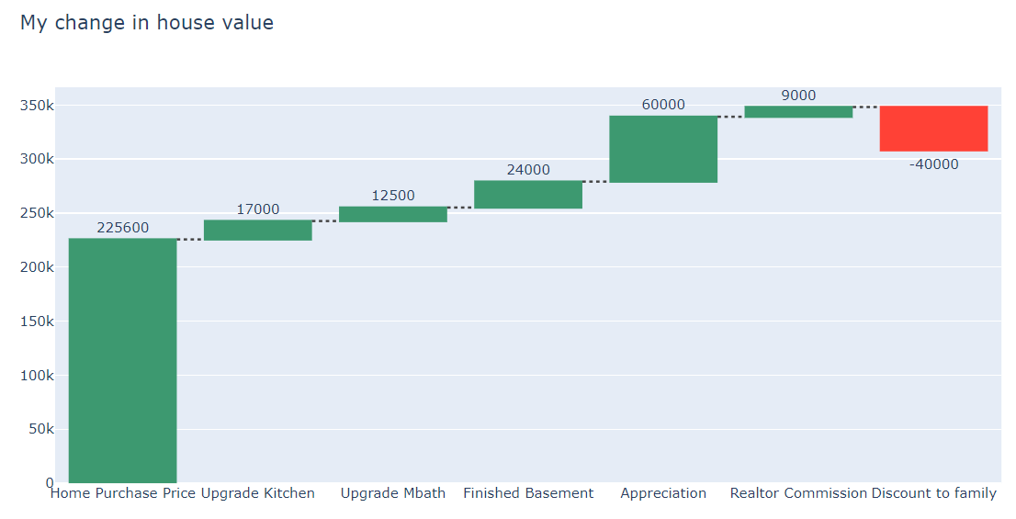
Python: Waterfall Plot

Slide 8
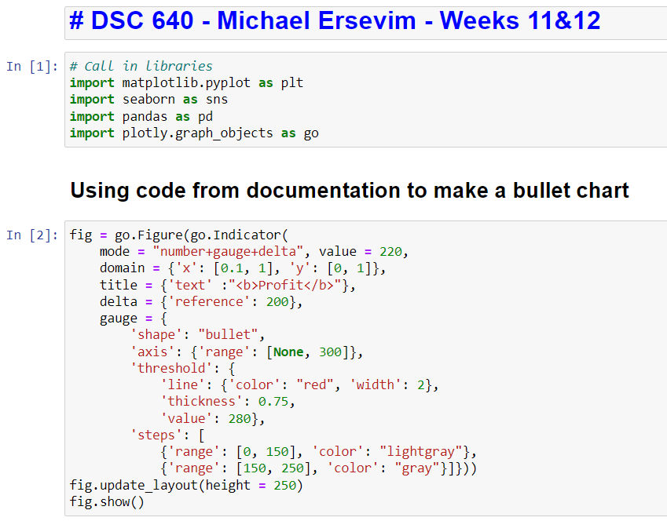
Python: CODE for generating graphs

Slide 9
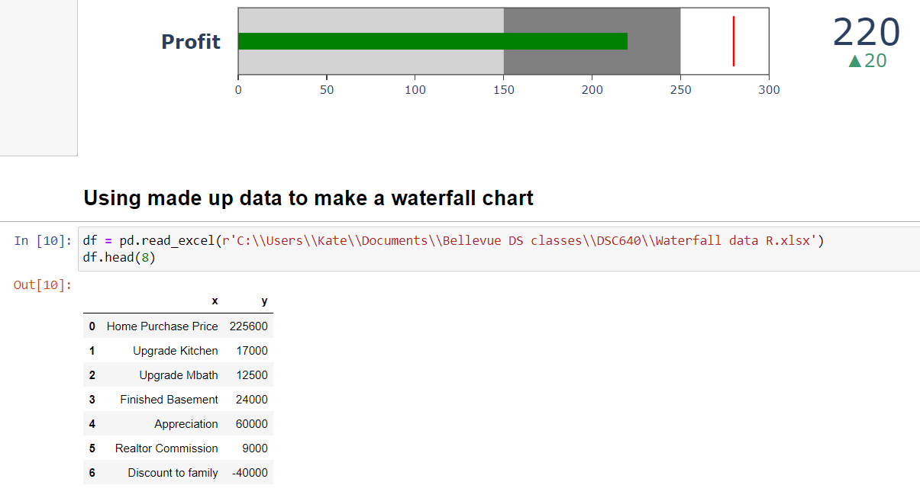
Python: CODE for generating bullet graph

Slide 10
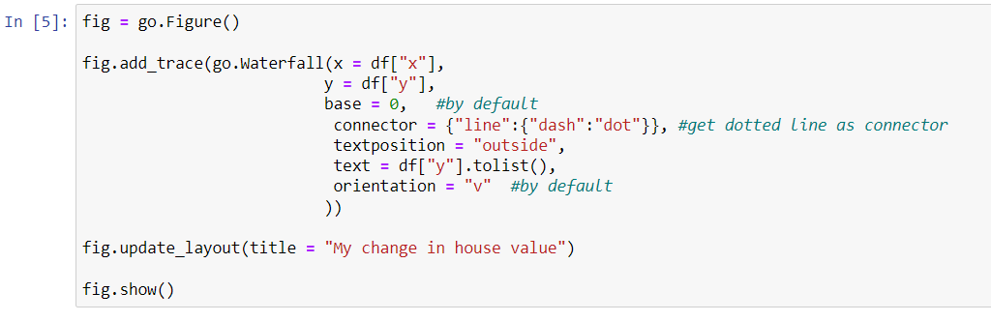
Python: CODE for generating graphs

Slide 11
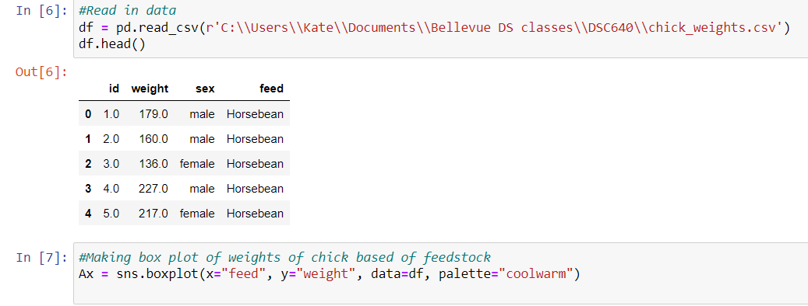
Python: CODE for generating graphs

Slide 12
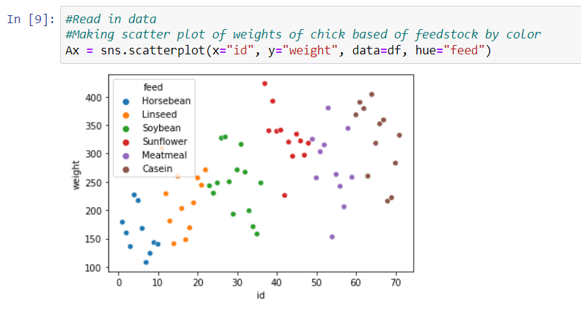
Python: CODE for generating scatterplot graph

Slide 13
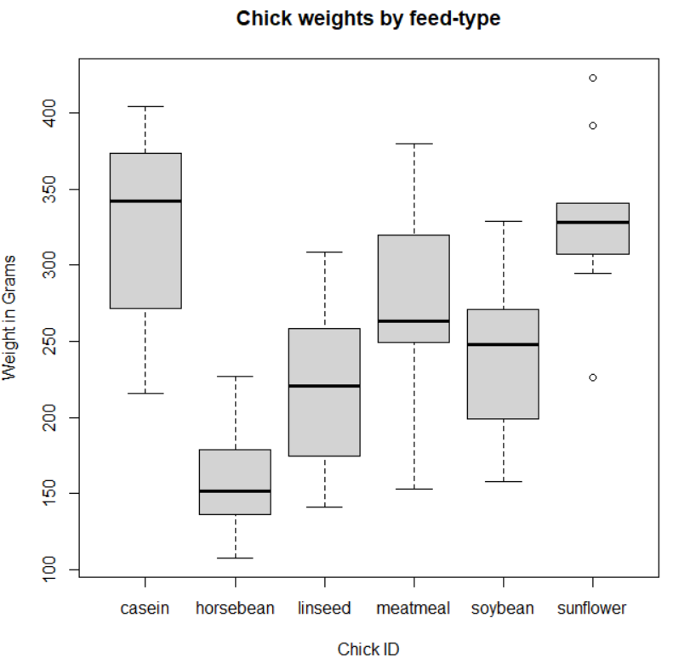
R: Box Plot

Slide 14
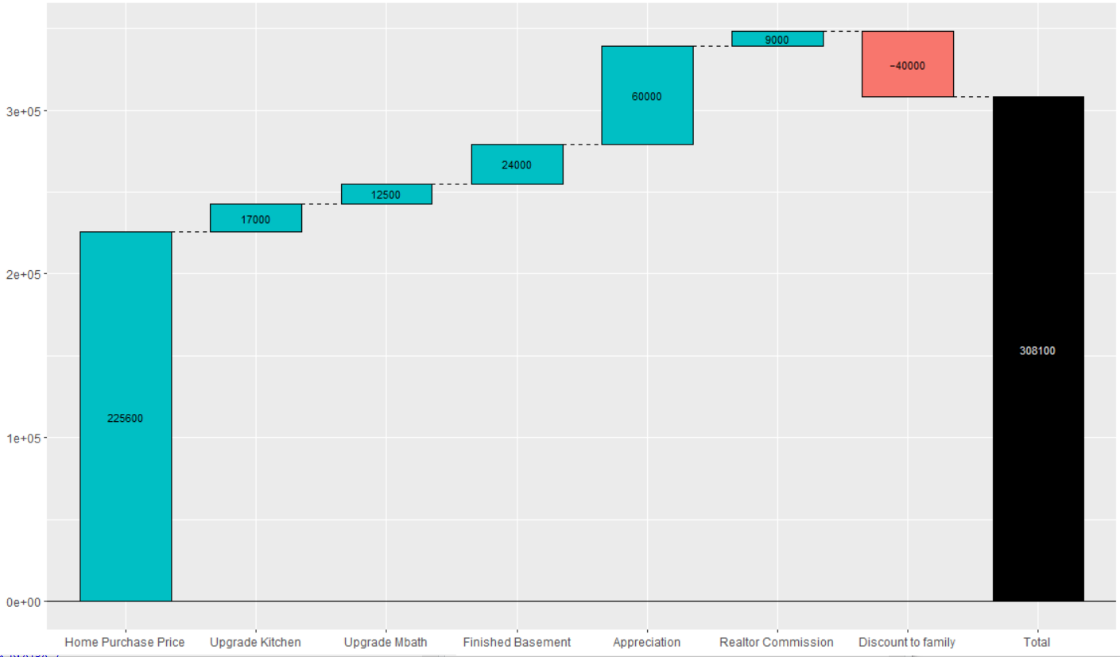
R: Waterfall Plot
Plot tracking the amounts and pieces of price change of a house between purchase and eventual sale, typically for more.

Slide 15
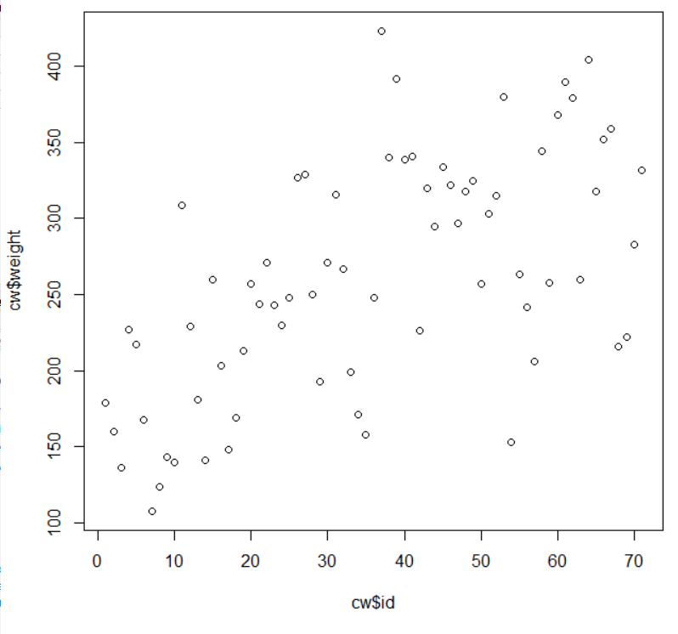
R: Scatter Plot
Scatter plot of weights against
Id number which has no real meaning except that the feed types are clustered together in groups. (Other plots had feed type denoted by color, like the previous Python scatter plot)

Slide 16
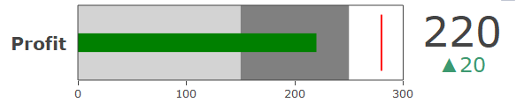
R: Bullet Chart
Bullet chart showing a simple example: Amount of profit is the black line, the amount is shown in text to the right. Differently shaded boxes can denote levels such as ‘poor’, ‘good’, ‘excellent’. Target lines drawn in red, and delta showing change since last measurement.

Slide 17
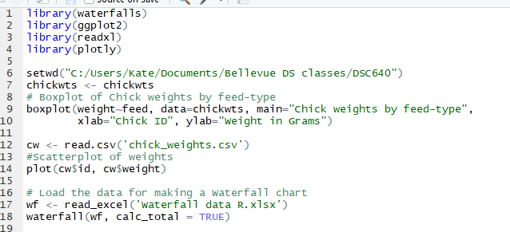
R: CODE for generating graphs

Slide 18
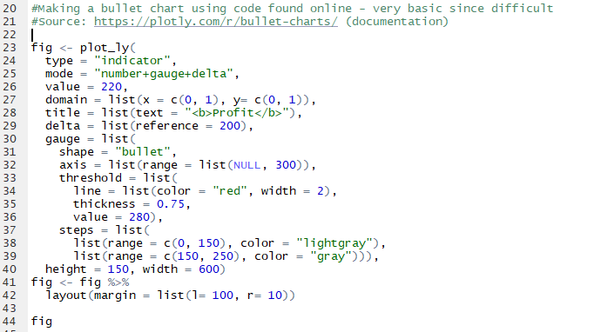
R: CODE for generating graphs

